Slide 1
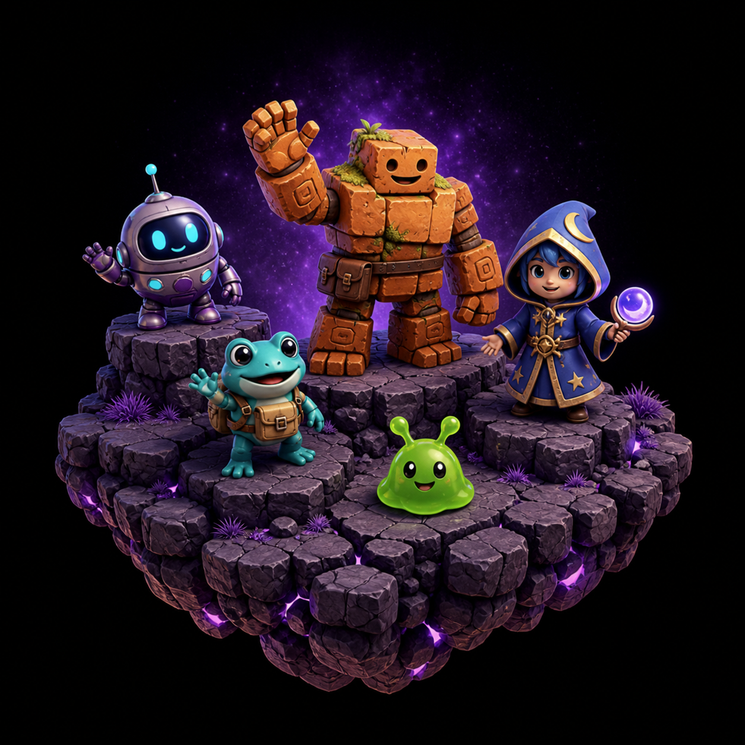
Game Programming, KFUPM
SWE 402, Lecture 1
Introduction to Game Dev Course
Dr. Omar Hammad, KFUPM
Notes:
Welcome
Introductory course for game dev
The goal of this course is to learn the essential skills design and develop video games

Slide 2
Why Game Dev?
Notes:
But before we start diving into this. Why would someone care about learning game development.

Slide 3

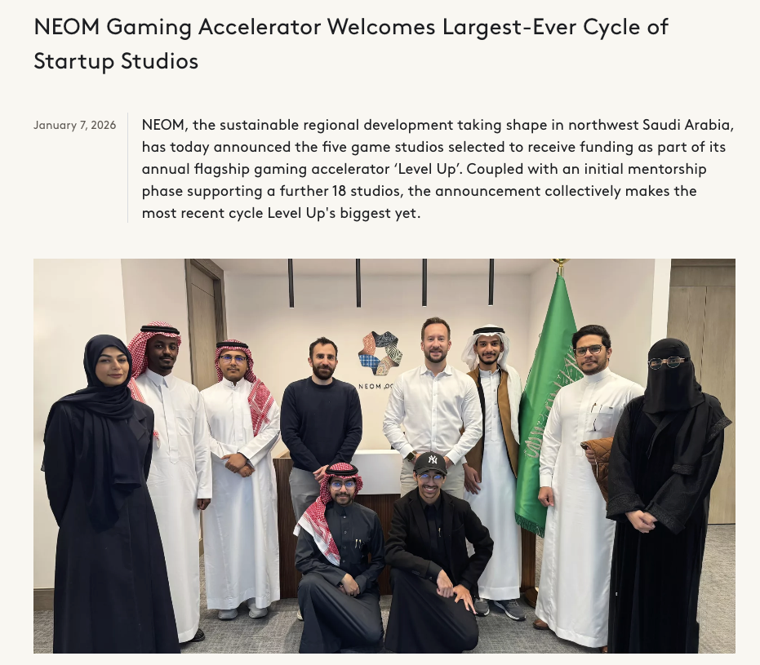
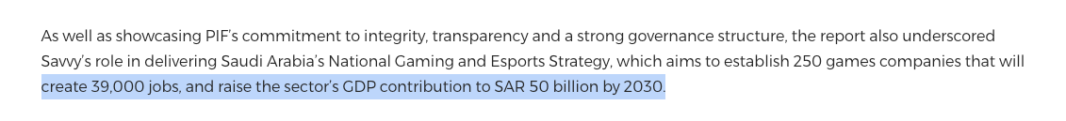
Why Game Dev
National priority
Strong Career
Startup opportunities
Export our culture
https://www.neom.com/en-us/newsroom/NEOM-Gaming-Accelerator-Welcomes-Largest-Ever-Cycle-of-Startup-Studios?utm_source=chatgpt.com
https://impact46.sa/saudi-vc-impact46-makes-sar-200m-bet-on-baloot-developer-in-landmark-gaming-deal/?utm_source=chatgpt.com
https://www.pif.gov.sa/en/news-and-insights/newswire/2024/savvy-games-group-publishes-its-first-annual-report/?utm_source=chatgpt.com
Notes:
Today, Saudi arabia is investing a lot into game development
A report produced by pif says that the goal is to establish 250 games companies
that will create 39000 jobs
and will raise the GDP by 50B by 2023
Recent acquisitions and investments in Saudi game studios also makes things more interesting
In august 2025, the well known game kemmelna was aquired by Impact46 for 200m SAR
Also NEOM throught theier gaming acceleration LevelUp have announced funding this year for 5 startup studios
And this is just the beginning

Slide 4

It is also Fun & Impactful!
Notes:
- This is not the only reason.
It is also a career path that is so exciting
Your job will be to make people having FUN
Your games can shape people minds
The need to expose our culture to the world is so important
And what can do that better than games

Slide 5
Knowing each other
Course structure
Teaching method
How to succeed in this course
In today’s lecture
Notes:
In today’s lecture, we will go over the following topics.
Knowing each other
Course structure
Teaching method
How to succeed in this course

Slide 6

What is your story?
Notes:
Let’s start by knowing each other
Have five mintes sketch things that you want to share
Write your name in the middle
send it to gpt and ask it to produce an image that look like a video game character
Send it to MS teams

Slide 7
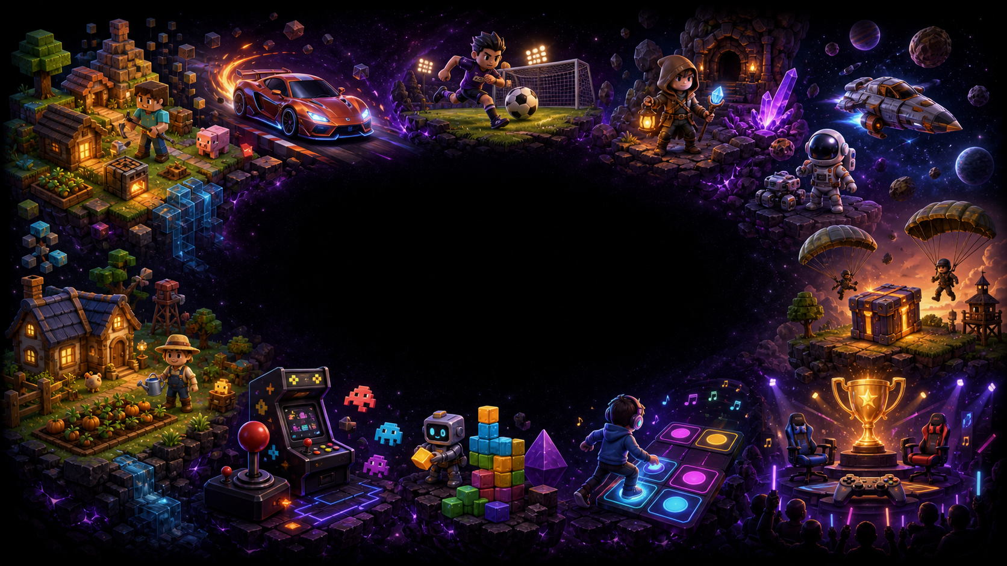
What is a game?
Notes:
What is a game? (Quick question to the class) If you had to define ‘game’ in one sentence, what would you say? There are many definitions, and each one emphasizes something different—rules, conflict, outcomes, or decision-making.

Slide 8

Multiple Definitions ..
“A closed formal system that engages players in structured conflict and resolves its uncertainty in an unequal out”
Game Design Workshop, Tracy Fullerton
Notes:
One strong definition comes from Tracy Fullerton (Game Design Workshop). She describes a game as a closed, formal system that engages players in structured conflict and resolves uncertainty with an unequal outcome. In other words: games create a world with boundaries (a system), they create tension (conflict), and they produce a result (someone wins, loses, or performs better).

Slide 9
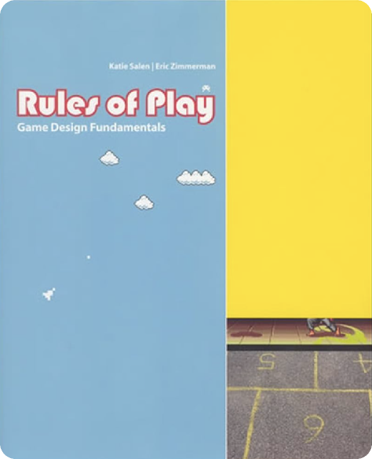
Multiple Definitions ..
“A system in which players engage in an artificial conflict, defined by rules that results in a quantifiable outcome”
Rules of Play, Katie Salen and Eric Zimmerman
Notes:
Another classic definition is from Katie Salen and Eric Zimmerman (Rules of Play). They define a game as a system where players engage in an artificial conflict, defined by rules, that results in a quantifiable outcome. Notice the emphasis here: ‘system’ + ‘rules’ + an outcome you can measure—score, time, ranking, win/loss.

Slide 10

Multiple Definitions ..
“A series of meaningful choices”
Sid Meier, Creator of Civilization
Notes:
A very famous—and very practical—definition comes from Sid Meier (Civilization): ‘A game is a series of meaningful choices.’ This is useful for us because it connects directly to design and programming. If the player’s choices don’t matter, the game becomes boring. If choices matter, then the game becomes strategic, emotional, and engaging.

Slide 11
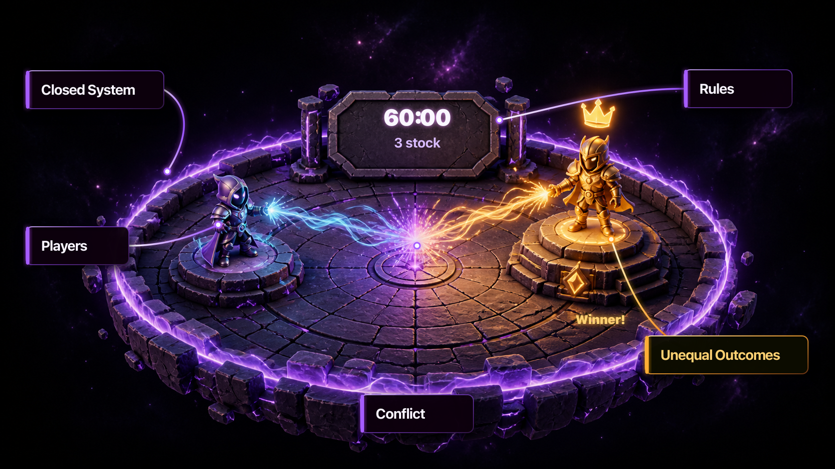
Core Elements of a game ..
Notes:
If we compare these definitions, most games share a few core elements: - A closed system (the game world has boundaries) - Rules (what is allowed / not allowed) - Players (one or more participants interacting with the system) - Structured conflict (challenge, competition, scarcity, risk) - Unequal outcomes (somebody ‘does better’ or wins) Even when a game is cooperative, there is still conflict—often against the environment or the system.

Slide 12
Let’s talk about the course
https://github.com/gamedevkfupm/swe402/
Notes:
Now let’s talk about the course
Under this url you will find a github repository
This repository contains all of what you need to succeed in the course
It will be a dynamic repo and will update it as we go
Lets discuss the syllabus for some time

Slide 13



https://learn.unity.com/pathways
Notes:
Finally regarding the material
After discussing with many experts in game development
They highly encourage the use of unity learn as a backbone of the course
It is well structured and is intereactive

Slide 14
Active learning class
Bring laptops
Prepare before class
Shared learning environment
Safe environment
Finaly guidelines
Notes:
Some guidelines that will help us run a fun class hopefully.

Slide 15

Game Programming, KFUPM
By Dr. Omar Hammad
join the discussion
MS TEAMS GAME DEV
Thank you
Notes:
Closing question (to check understanding): If you had to pick ONE milestone that changed game development the most—what would it be, and why? Is it: - arcades (public access) - consoles (home gaming) - online multiplayer (social + scale) - mobile (distribution + new audience) Post your answer in the discussion channel.

